Slide 1


Titolo presentazione sottotitolo
DAAP – HW1 Talking Instrument
Milano, XX mese 20XX
Xinmeng Luan - 10876787
Marco Bernasconi - 10669941

Slide 2
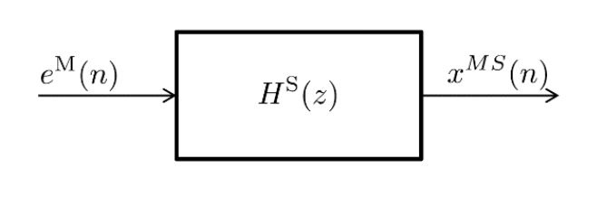

Introduction
Music
Speech
Talking instrument
1. Wiener filtering approach
2. steepest descent method
Method

Slide 3
3. auto-correlation
-> r ,R
4. If method 1 (Wiener filtering approach)
-> a (vector of optimum coefficients )
If method 2 (steepest descent method)
Steps of iteration: 2000
-> The necessary and sufficient condition for the convergence or stability -> mu, tau
-> Transient behaviour test -> c, v (plot)
-> a
5. Frequency filter
-> A, H
6. OLA
7. Get audio file
8.Plot spectrogram

Slide 4
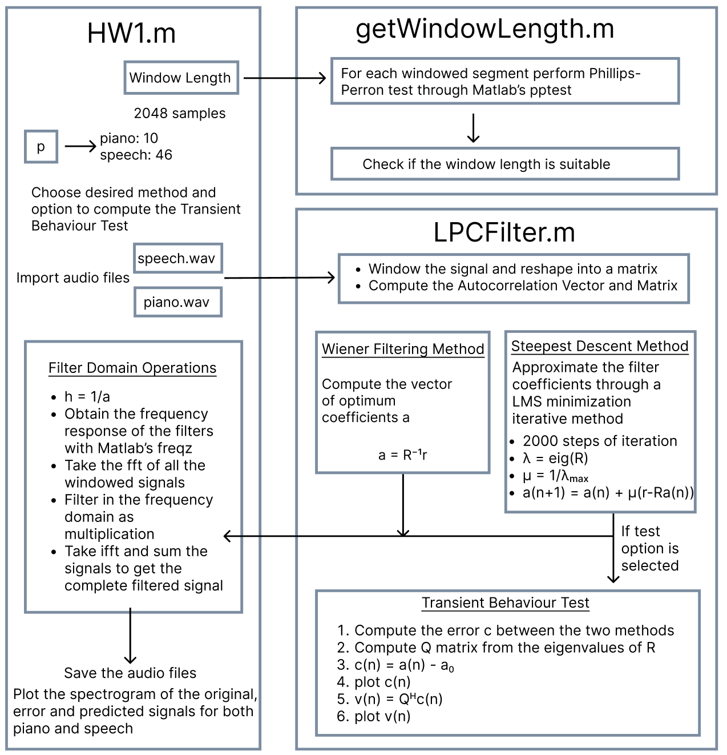
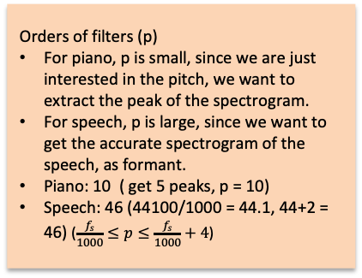
Pipeline
Orders of filters (p)
For piano, p is small, since we are just interested in the pitch, we want to extract the peak of the spectrogram.
For speech, p is large, since we want to get the accurate spectrogram of the speech, as formant.
Piano: 10 ( get 5 peaks, p = 10)
Speech: 46 (44100/1000 = 44.1, 44+2 = 46) ($\frac{f_{s}}{1000}≤p≤\frac{f_{s}}{1000}+4$)
Windowing:
Hanning window
Stationary test
COLA (hop-size: 25%)

Slide 5
Comparision

